Slide 1
Constructor & destructor in c++
CSE 213 – OOPL
Instructor-
Mousumi Hasan,
Assistant Professor, CSE Dept, BAIUST

Slide 2
What is a constructor?
It is a member function which initializes a class.
A constructor has:
(i) the same name as the class itself
(ii) no return type (not even void)
(iii) Called automatically when object is created

Slide 3
Example of Constructor
#include <iostream>
using namespace std;
class Student {
public:
Student() {
cout << "Default Constructor Called" << endl;
}
};
int main() {
Student s1;
return 0;
}

Slide 4
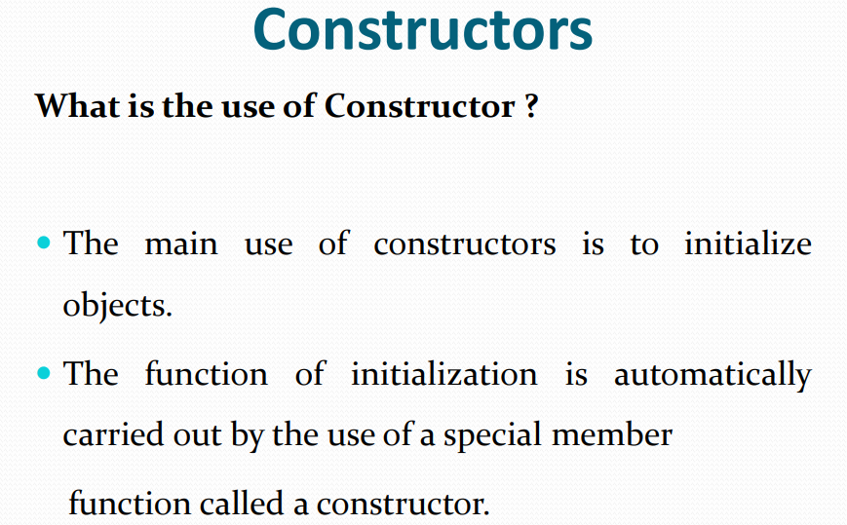

Slide 5
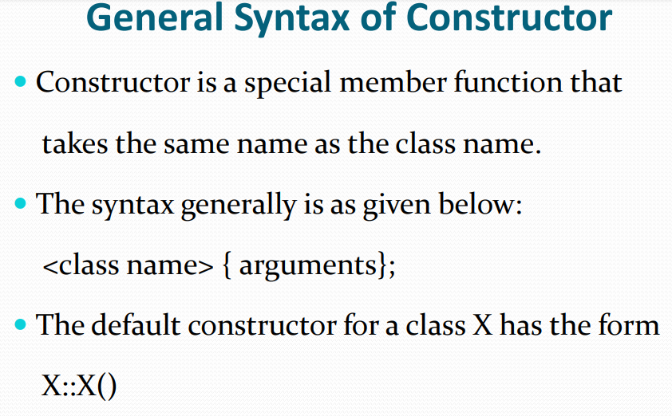

Slide 6
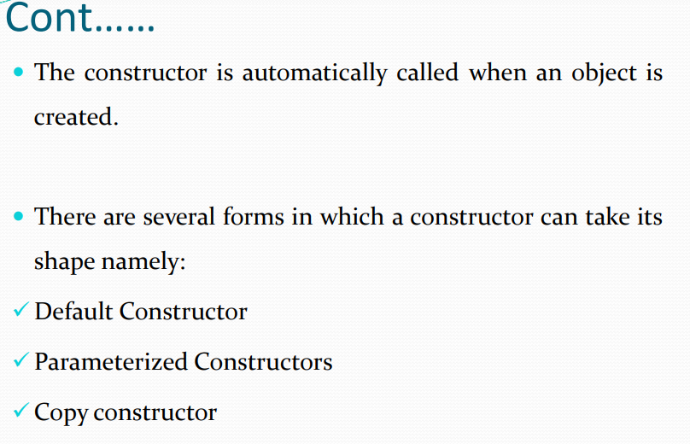

Slide 7
Default Constructor
#include <iostream>
using namespace std;
class Rectangle {
int length, width;
public:
// Default Constructor
Rectangle() {
length = 10;
width = 5;
}
void display() {
cout << "Length: " << length << endl;
cout << "Width: " << width << endl;
cout << "Area: " << length * width << endl;
}
};
int main() {
Rectangle r1; // Default constructor automatically called
r1.display();
return 0;
}

Slide 8
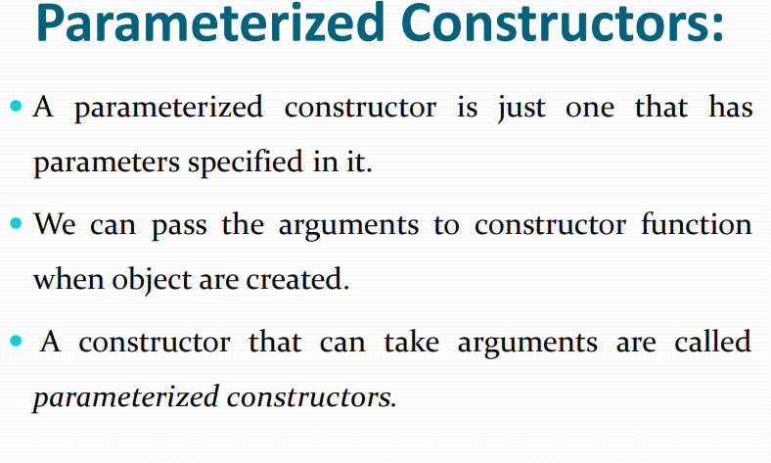

Slide 9
Parameterized Constructor
#include <iostream>
using namespace std;
class Student {
int id;
public:
Student(int x) {
id = x;
cout << "ID: " << id << endl;
}
};
int main() {
Student s1(101);
return 0;
}

Slide 10
What is a copy constructor?
It is a member function which initializes an object using another object of the same class.
A copy constructor has the following general function prototype:
class_name (const class_name &obj);

Slide 11
#include <iostream>
using namespace std;
class Student {
int id;
public:
Student(int x) {
id = x;
}
Student(const Student &s) {
id = s.id;
cout << "Copied ID: " << id << endl;
}
};
int main() {
Student s1(101);
Student s2 = s1; // Copy constructor
return 0;
}

Slide 12
Overloading constructors
You can have more than one constructor in a class, as long as each has a different list of arguments.
#include <iostream>
using namespace std;
class Student {
public:
Student() {
cout << "Default Constructor" << endl;
}
Student(int x) {
cout << "Parameterized Constructor: " << x << endl;
}
};
int main() {
Student s1;
Student s2(50);
return 0;
}

Slide 13
Overloading constructors (cont.)
#include <iostream> using namespace std; class BankAccount { string name; int accountNumber; double balance; public: // Default Constructor BankAccount() { name = "Not Provided"; accountNumber = 0; balance = 0.0; } // Constructor with name and account number BankAccount(string n, int accNo) { name = n; accountNumber = accNo; balance = 0.0; }
// Constructor with all details BankAccount(string n, int accNo, double bal) { name = n; accountNumber = accNo; balance = bal; } void display() { cout << "Name: " << name << endl; cout << "Account Number: " << accountNumber << endl; cout << "Balance: " << balance << endl; cout << "------------------------" << endl; } };

Slide 14
int main() { // Different ways of creating objects BankAccount a1; // Default constructor BankAccount a2("Rahim", 101); // Partial info BankAccount a3("Karim", 102, 5000.50); // Full info a1.display(); a2.display(); a3.display(); return 0; }

Slide 15
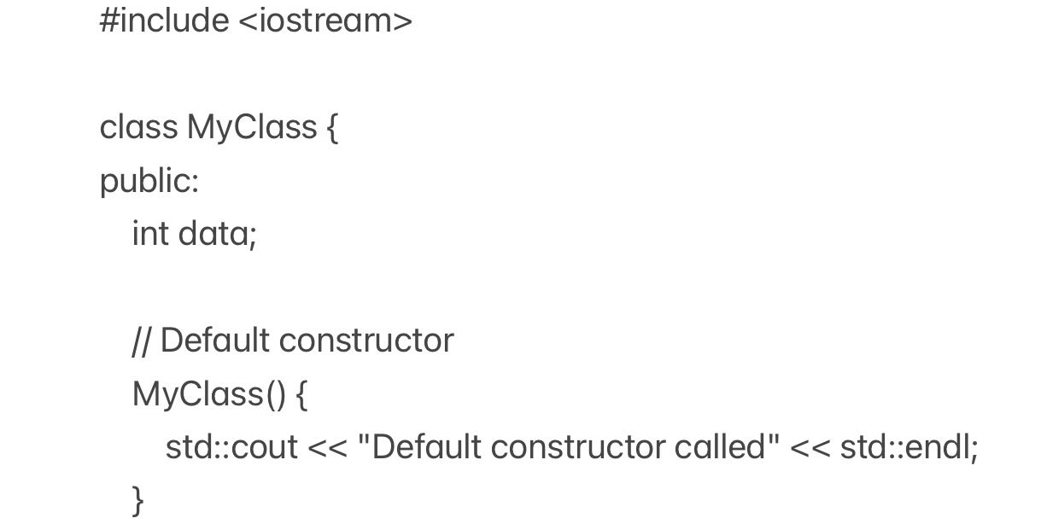
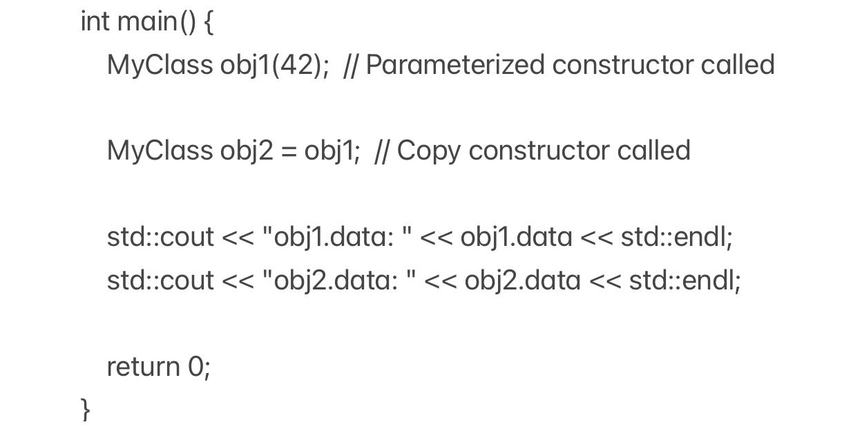
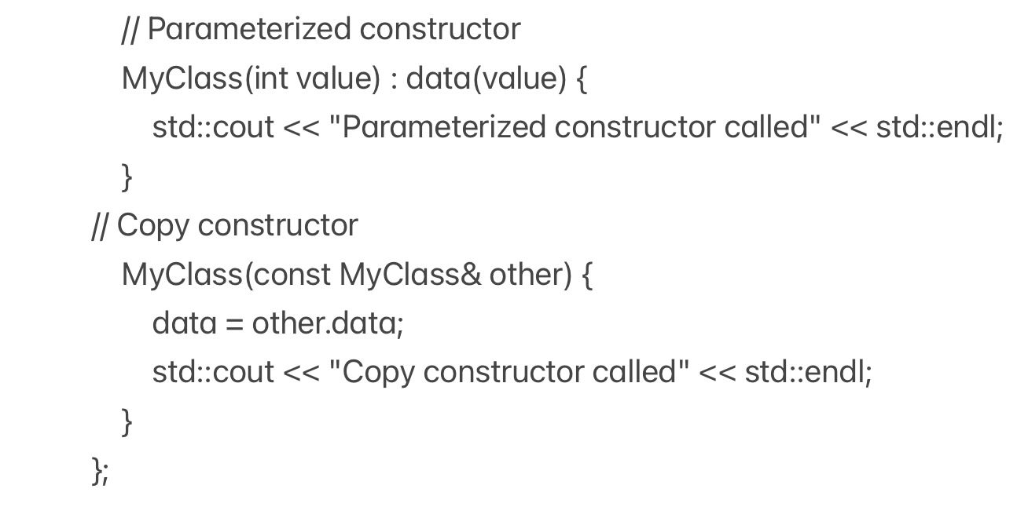
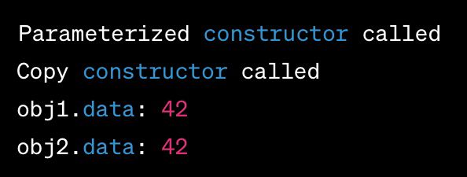
Example of constructor

Slide 16
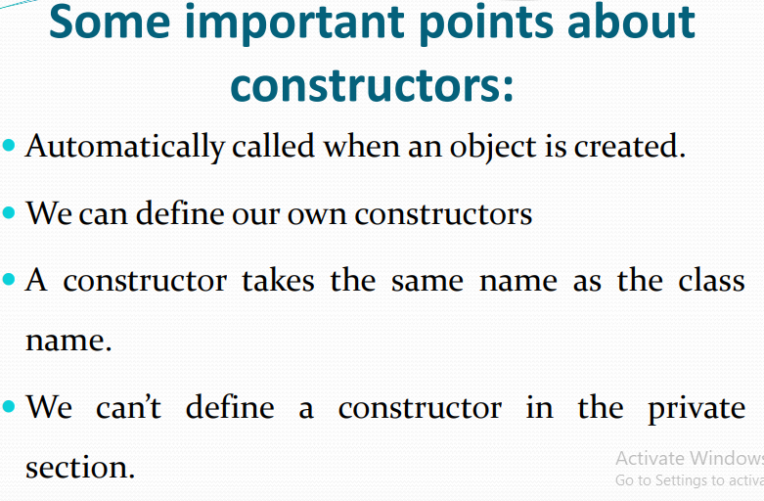

Slide 17
What is a destructor?
It is a member function which deletes an object.
A destructor function is called automatically when the object goes out of scope:
(1) the function ends
(2) the program ends
(3) a block containing temporary variables ends
(4) a delete operator is called
A destructor has:
(i) the same name as the class but is preceded by a tilde (~)
(ii) no arguments and return no values

Slide 18
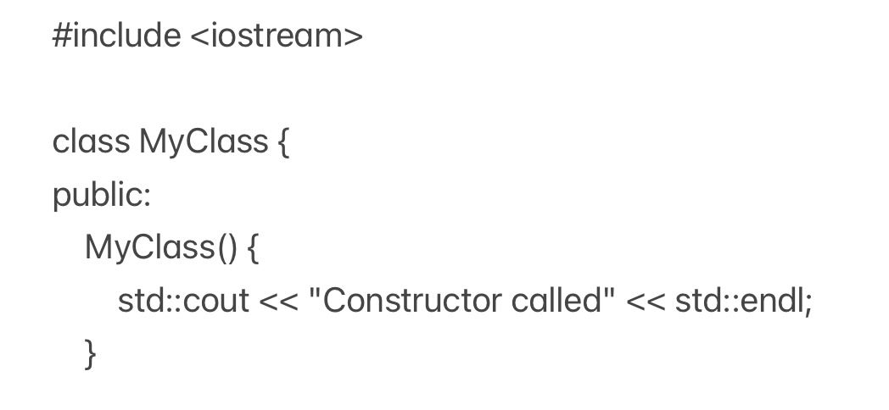
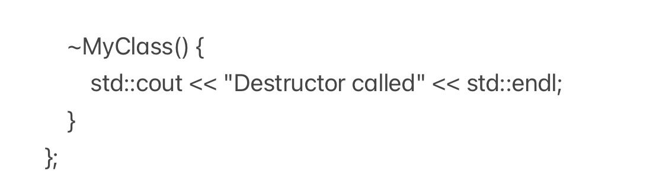
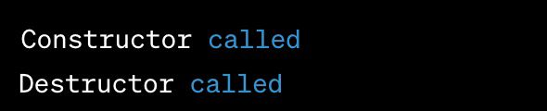
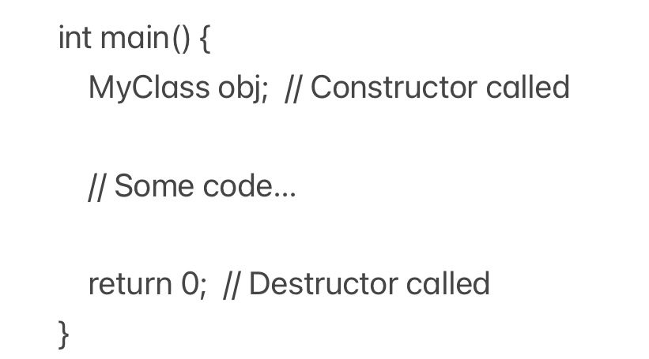
Example of destructor

Slide 19
#include<iostream>
#include <iostream>
using namespace std;
class Demo {
int id;
public:
Demo(int i) {
id = i;
cout << "Constructor called for object " << id << endl;
}
~Demo() {
cout << "Destructor called for object " << id << endl;
}
};
int main() {
cout << "Creating objects..." << endl;
Demo obj1(1);
Demo obj2(2);
Demo obj3(3);
cout << "End of main function..." << endl;
return 0;
}

Slide 20
#include <iostream>
using namespace std;
class Demo {
int id;
public:
// Constructor
Demo(int i = 0) {
id = i;
cout << "Constructor called for object " << id << endl;
}
// Destructor
~Demo() {
cout << "Destructor called for object " << id << endl;
}
};
int main() {
cout << "Creating array of objects..." << endl;
Demo arr[3] = { Demo(1), Demo(2), Demo(3) };
cout << "End of main function..." << endl;
return 0;
}

Slide 21
Comments on destructors
If you do not specify a destructor, the compiler generates a default destructor for you.
When a class contains a pointer to memory you allocate, it is your responsibility to release the memory before the class instance is destroyed.
It is a good practice to declare destructors in a program since it releases memory space for further use.

Slide 22
Tasks
1.Create a class Student with:
data members: name, id
a default constructor that initializes values
a function to display data
Task: Create an object and print student details.
2.Create a class Rectangle:
Use a parameterized constructor to initialize length and width
Calculate and display area
3.Create a class Employee:
Data: name, salary
Use constructor overloading:
default constructor
constructor with name
constructor with name and salary
Display employee details for each case.

Slide 23
4. Create a class Book:
Data: title, price
Implement a copy constructor
Copy one object into another and display both
Question: What happens if copy constructor is not defined?
5. Create a class BankAccount:
Data: accountNumber, balance
Constructor initializes values
Destructor displays message: "Account closed"
Create multiple objects and observe destructor calls.

Slide 24
Importance of Constructor
1. Automatic Initialization
2. Ensures Object Consistency
3. Code Reusability and Clean Design
4. Supports Multiple Ways of Object Creation (Overloading)
5. Helps in Resource Allocation
6. Works with Destructor for Resource Management

Slide 25
THANK YOU!!!

